Slide 2
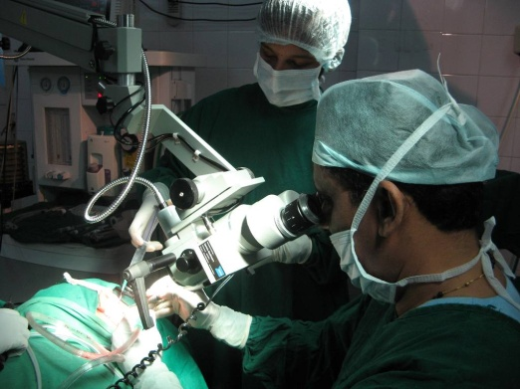
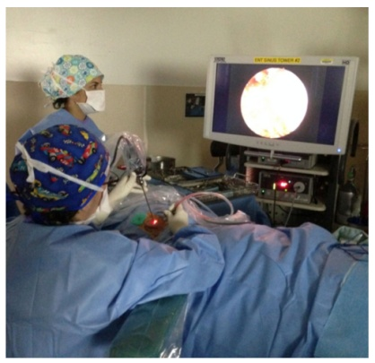
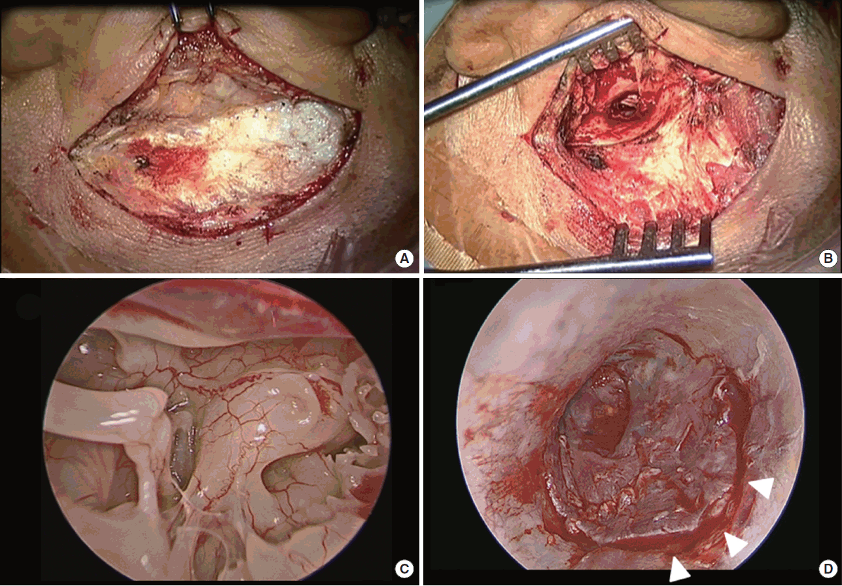
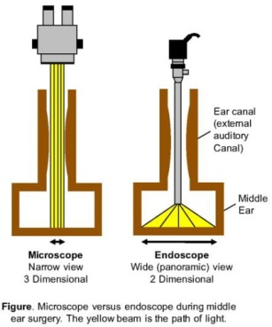
A
B
C
D

Slide 3
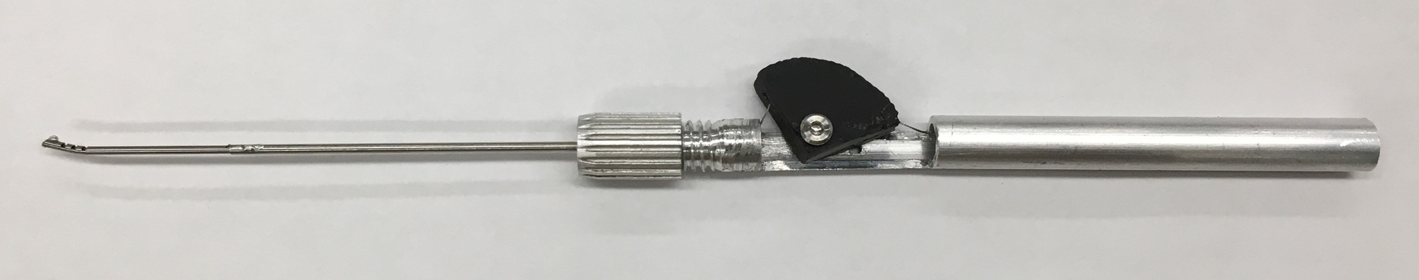
finger piece
wrist
stainless steel shaft
collet clamp
cable
handle
This shows the prototype with the wrist, notches milled into a nitinol tube, connected to a stainless steel shaft that is clamped onto the handle that consists of a finger piece that controls the cable displacement of the cable attached to the nitinol wrist. Moving the finger piece back causes cable displacement and thus wrist actuation.

Slide 4
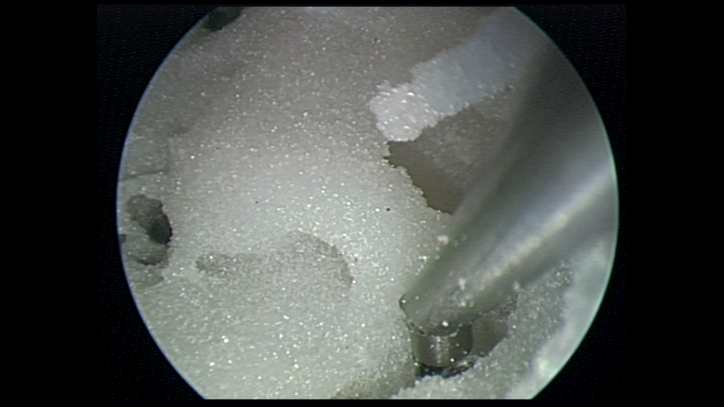
Promontory
Sinus Tympani
This is a model of the left temporal bone. The promontory is a landmark bone inside the middle ear, behind the ossicles. The sinus tympani is shown and is very difficult to reach into with standard, rigid tools to dissect and remove cholesteatoma. Often, the cholesteatoma is visualized in the sinus tympani with the endoscope but the tools cannot reach inside to extract it. This image shows, with an endoscope view, that the controllable, flexible instrument can reach into the sinus tympani.

Slide 5
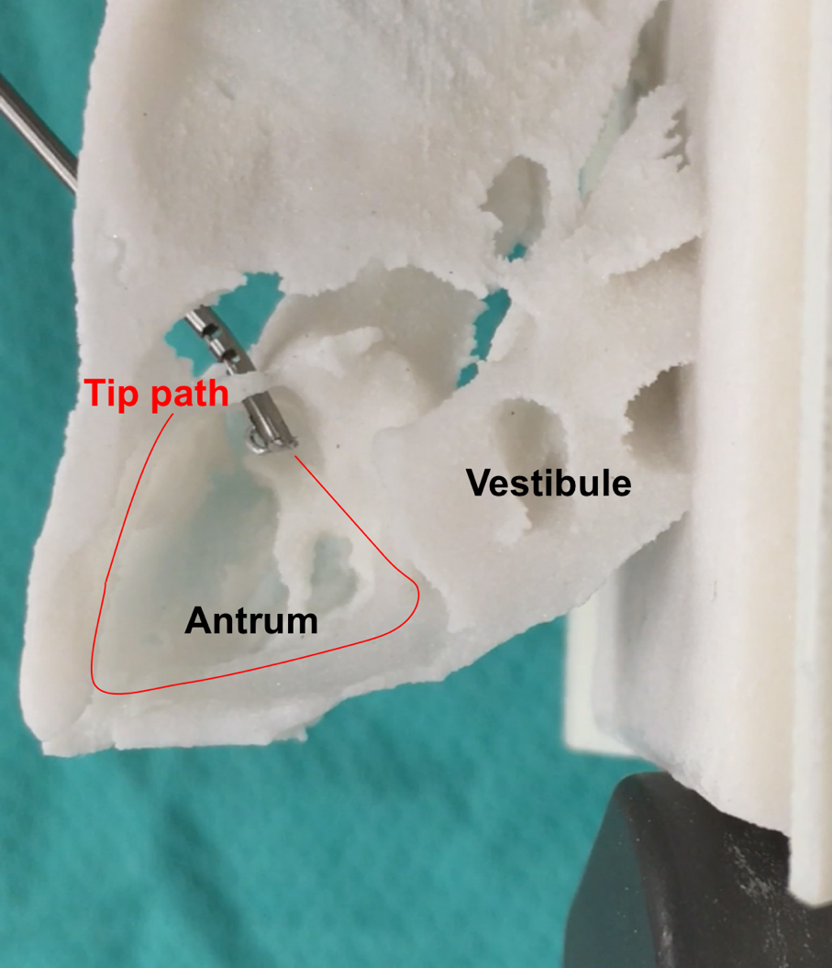
This is a model of the left temporal bone. The model has been cropped so that the antrum is visible in this bird’s eye view. Cholesteatoma had eroded the ear canal in this patient like an atticoantrostomy, a hole in the ear canal where the instrument is coming through. Thus, the instrument is introduced through that opening and the tip can reach and dissect the boundary of the antrum.

Slide 6
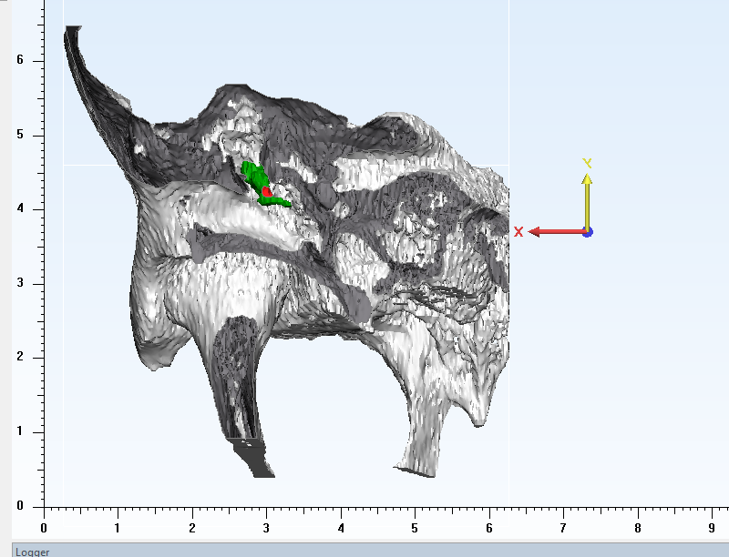
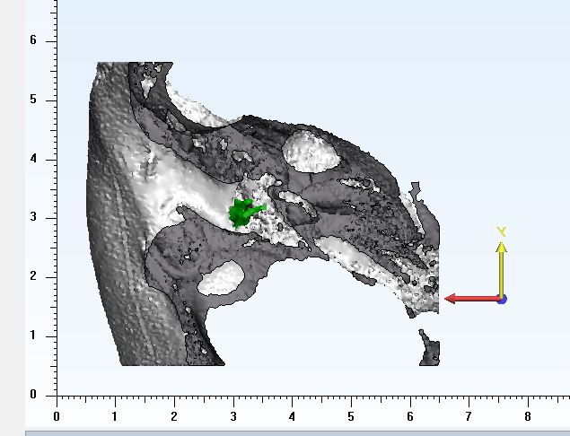
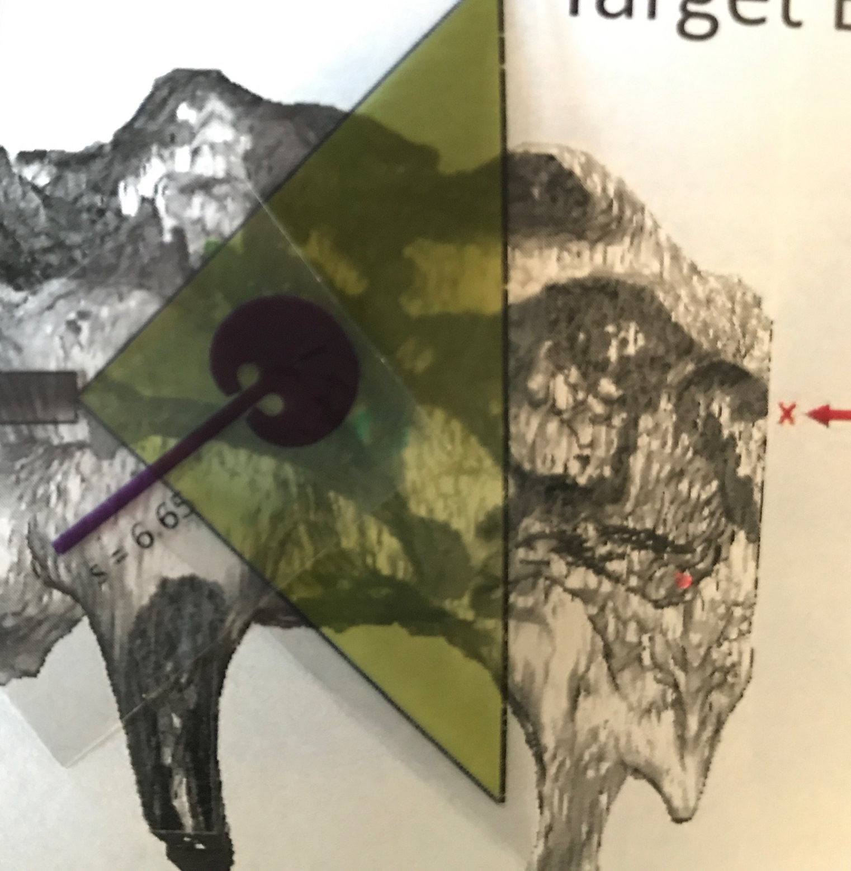
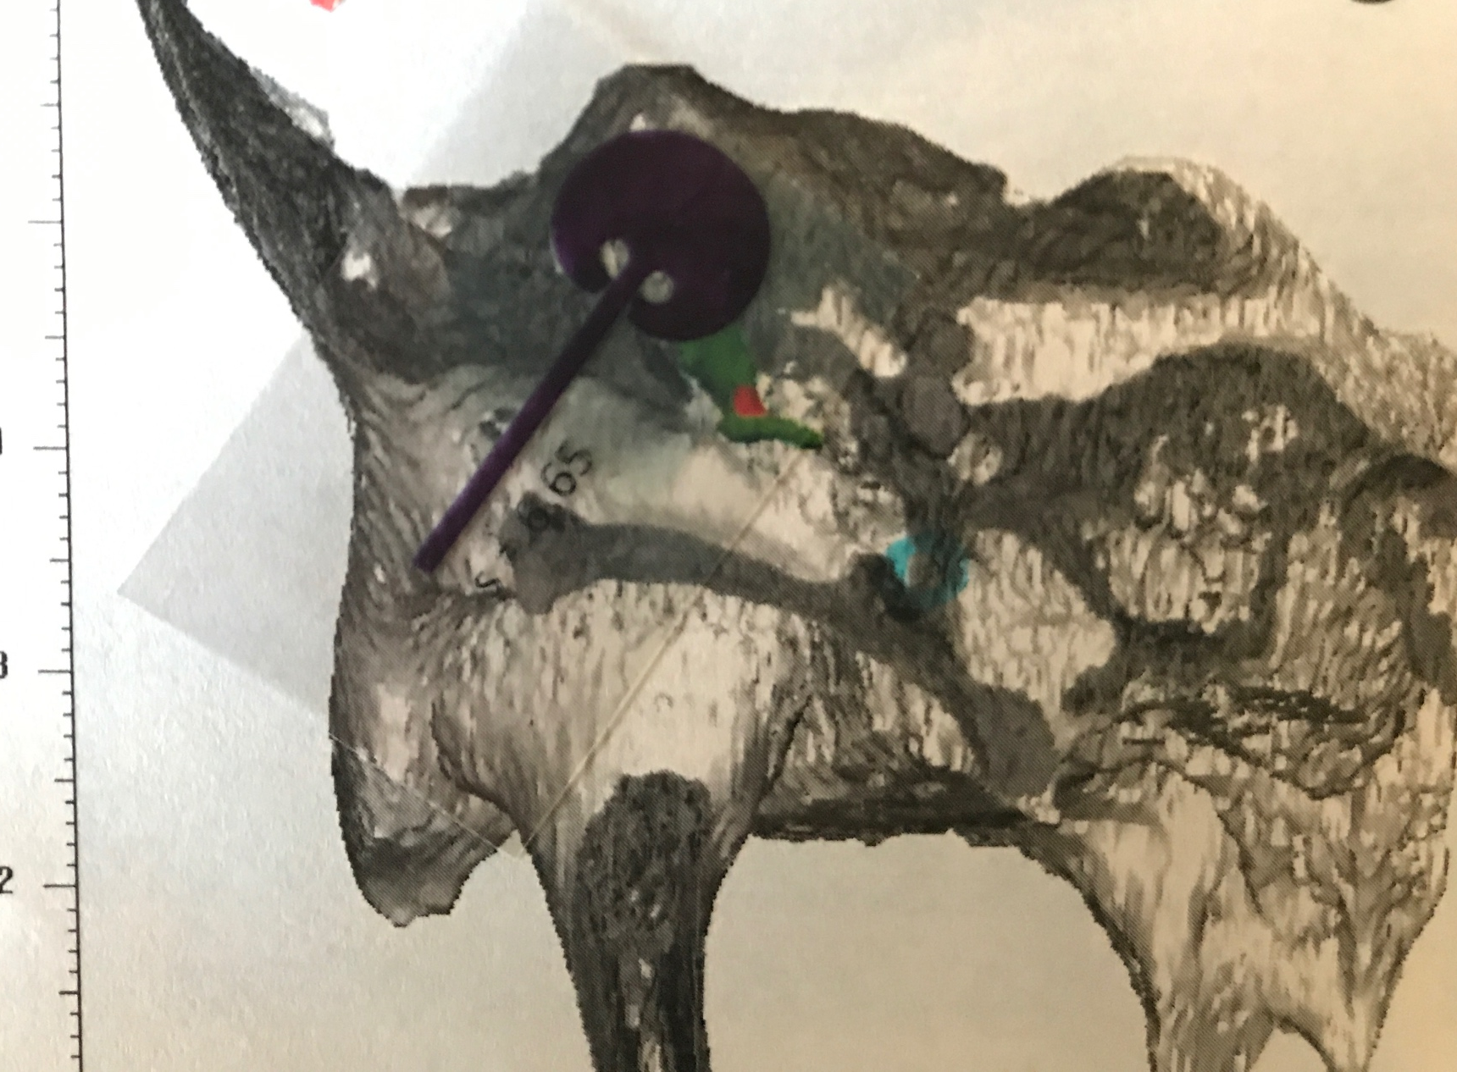
Antrum
Ossicles
Sinus tympani
Ossicles
3D virtual model of temporal bone anatomy used to identify structures for the new tool to reach.

Slide 7
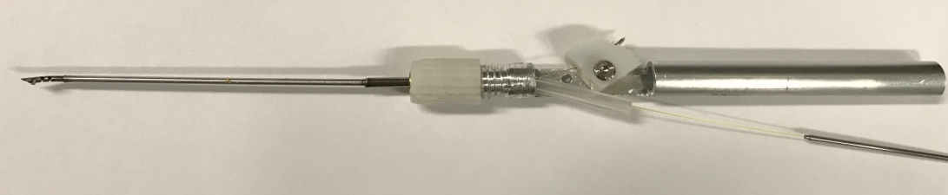
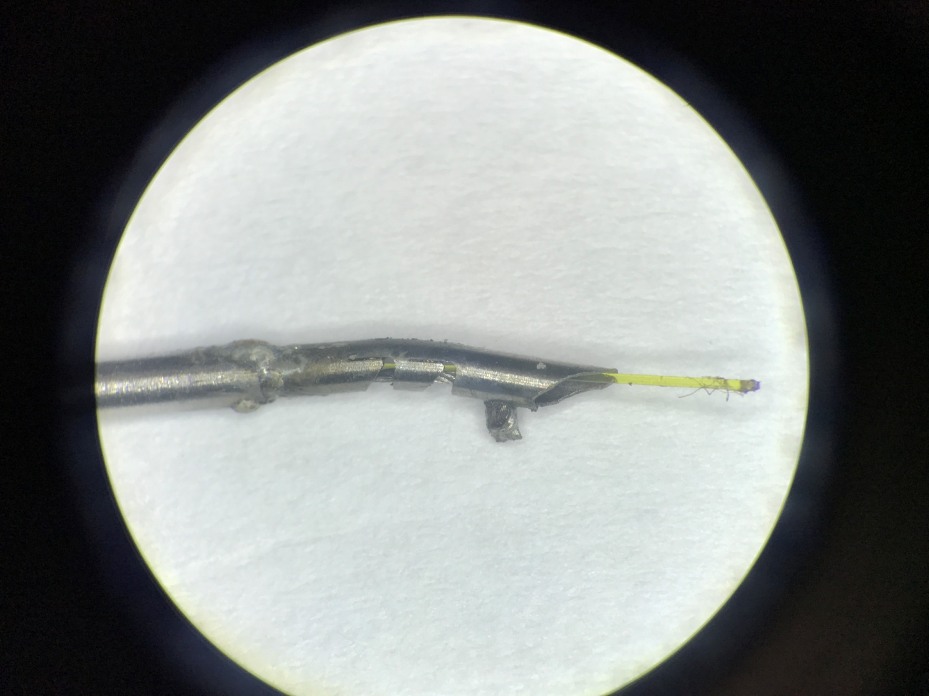
Thumb Piece
Collet Assembly
Handle
Shaft
Wrist
Laser Fibre
Laser Fibre
Cable

Slide 8
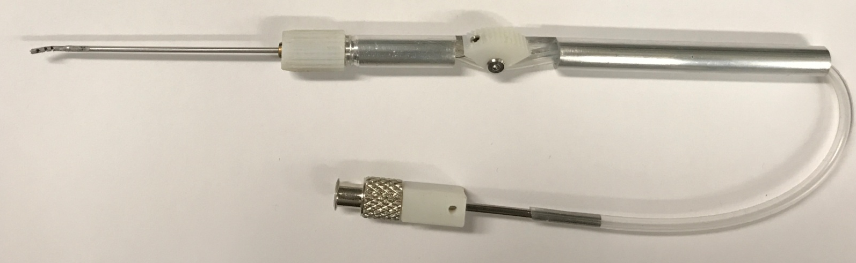
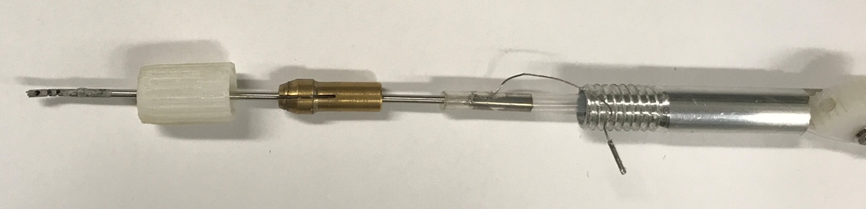
Wrist
Thumb Piece
Handle
Shaft
Luer Lock
Connector
Tubing
Collet Assembly
Collet Clamp
Cable
Collet
Tubing
Adaptor Tube

Slide 9
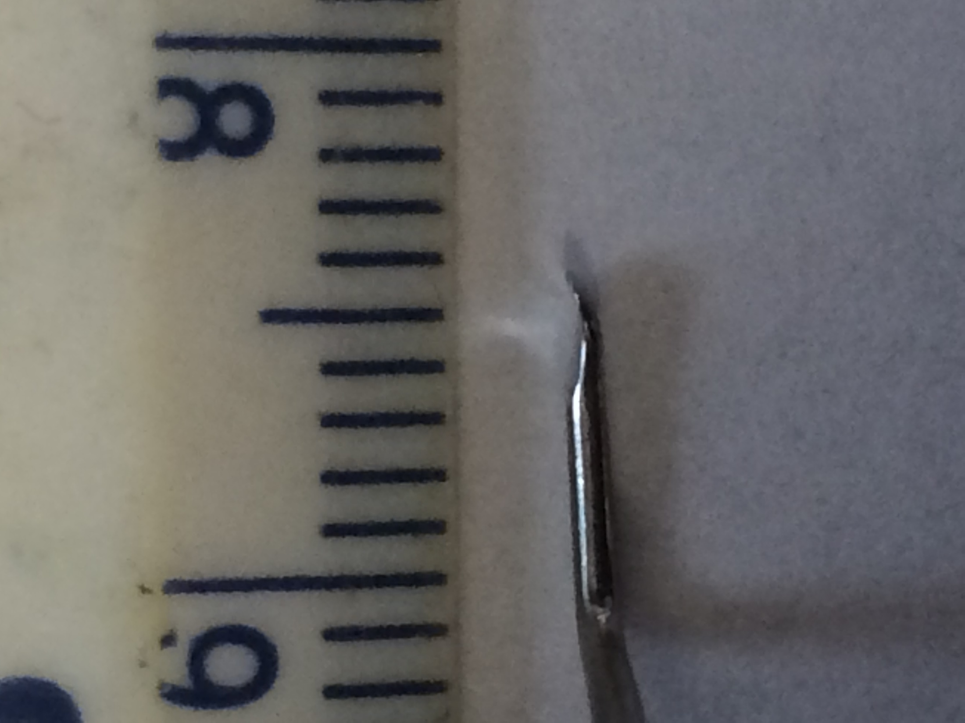
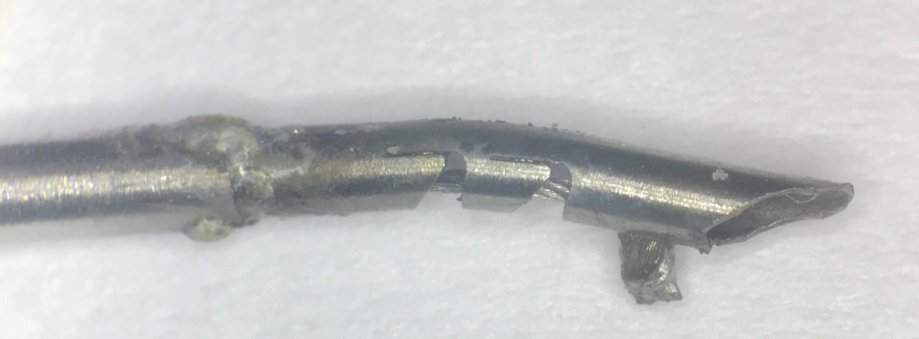
Proposed Tool Dissector Tip
Thomassin Dissector Tip

